Slide 1

Lakshmi Narayan College of Technology & Science Bhopal
Major Project Presentation
E-Notebook
Submitted by
Hardik Rawat (0157EC181036) Diksha Singh (0157EC181030)
Divyansh Yadav(0157EC181031) Lakshmi Kumari(0157EC181047)
Department of Electronics and Communication Engineering
2021-2022
Under the guidance of: Under the Supervision of
Dr. Aparna Gupta Niketan Mishra

Slide 2
INTRODUCTION OF THE PROJECT
Enote book is a web application that is developed in java using servlet, jsp , html, css , bootstrap ,oracle. This a Simple Note App where we can write and upload note from any where and we can access from any where any time. Taking about the features of this system,
The user can make the list of their daily work that they have to do and keep them as records.
The user should able to create ,edit and delete,save a note.
The user should be able to see the date and time of the creation of the note.
The users should have to resgister here to make a note.

Slide 3
Survey
Today Life is very fast. Everyone wants his work to be done very fast with to much effort and it is not possible without computer. Computer is only that medium that helps us in every field like saving details, information, accurate and fast .
The main aim of this web app is to facilitate the user friendly environment of bluebook implementation and reduce the manipulation manual efforts.
This system is helpful to take the list of their daily work that they have to do or note and keep them as records. We can also perfom crud operation like create,edit and delete of note . Easy to access from any where ,any time.

Slide 4
Survey
In our past when there was no Desktop Applications the user use to make a note in normal way and it take lots of time and we have to use pen,paper and keep the notes properly .Which was so time consuming and we have to carry the notes all time.
This web app will reduce the manipulation manual efforts.
We can access the note from any device.

Slide 5
Project Database
In this project Oracle Database is used.
Oracle database (Oracle DB) is a relational database management system (RDBMS) from the Oracle Corporation. Oracle DB is one of the most trusted and widely-used relational database engines.
The system is built around a relational database framework in which data objects may be directly accessed by users (or an application front end) through structured query language (SQL). Oracle is a fully scalable relational database architecture and is often used by global enterprises, which manage and process data across wide and local area networks. The Oracle database has its own network component to allow communications across networks.
Oracle DB is also known as Oracle RDBMS and, sometimes, just Oracle.

Slide 6
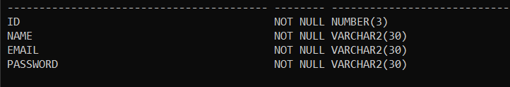
Project Database
In this we have two table Users and Post.
In Users table we have userid,name,email,password.
In Post table we have id,title,content,time,userid.
Primary key
Users table

Slide 7
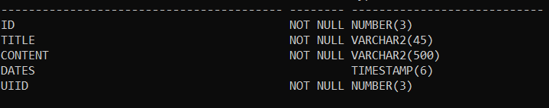
Project Database
Foreign key
Post table

Slide 8
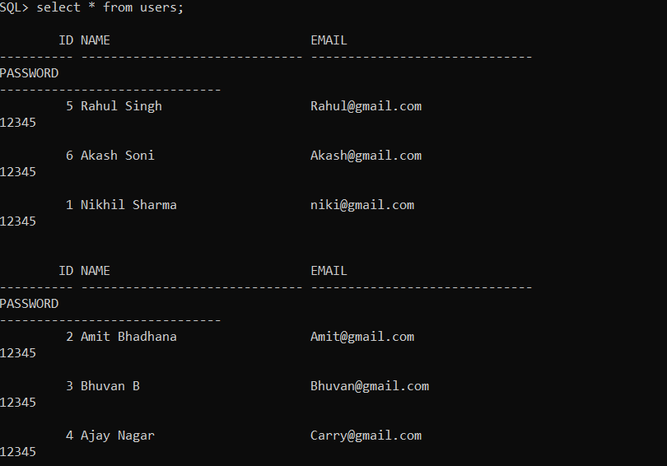
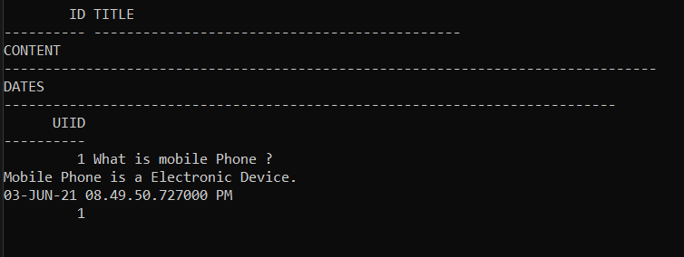
Project Database
Users table
Post table

Slide 9
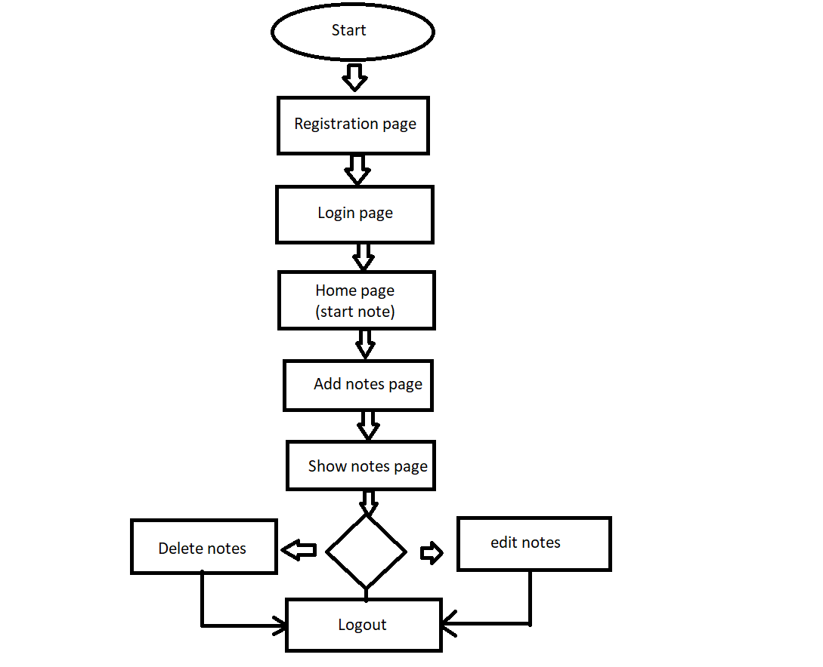
Flowchart

Slide 10
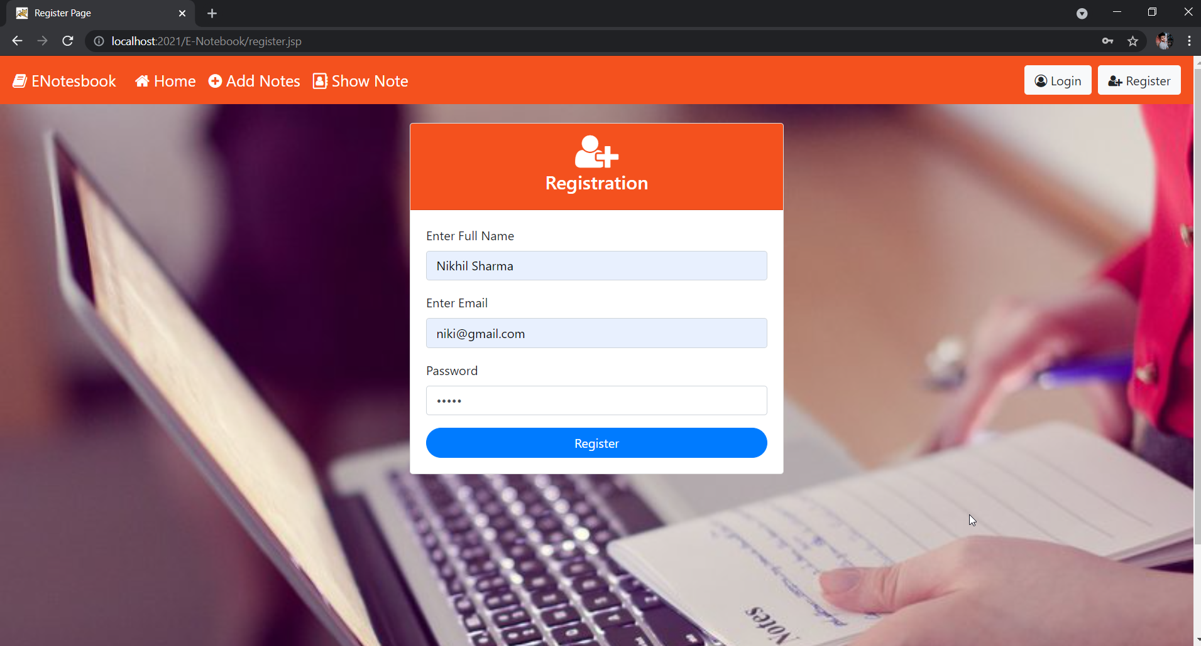
Registration page

Slide 11
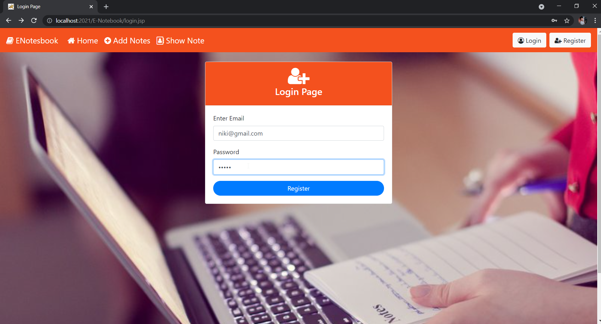
Login page

Slide 12
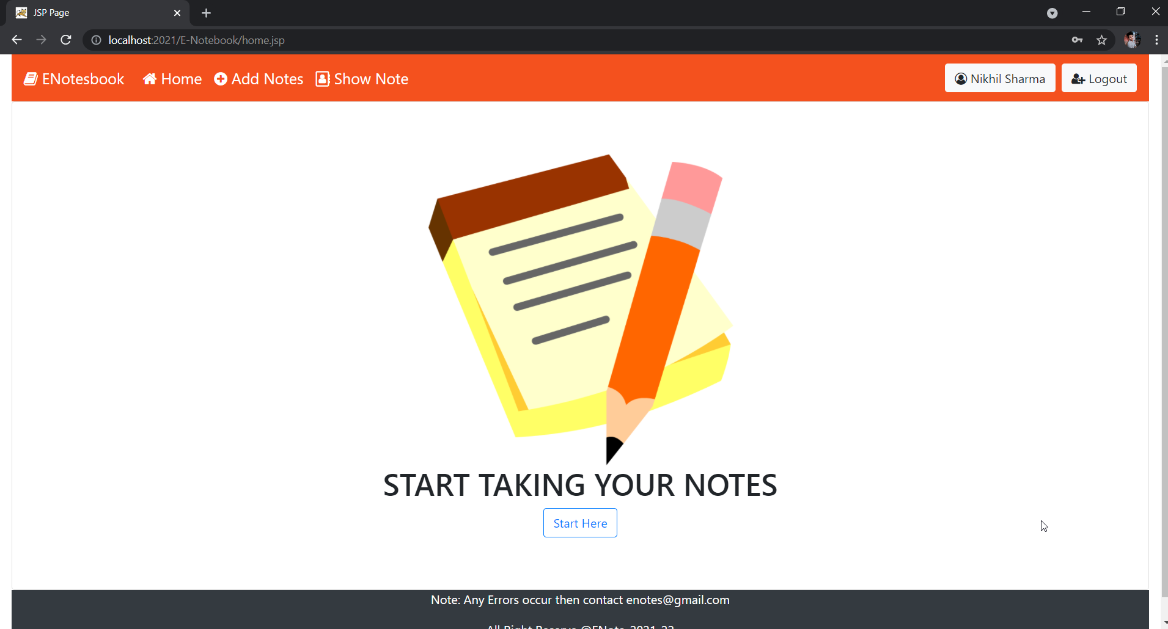
Home page

Slide 13
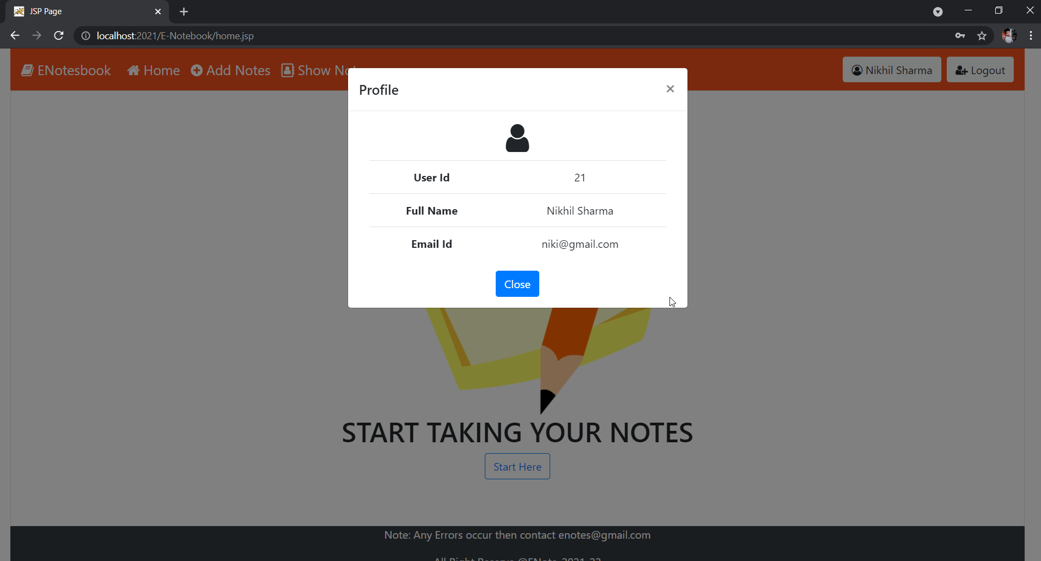
User profile

Slide 14
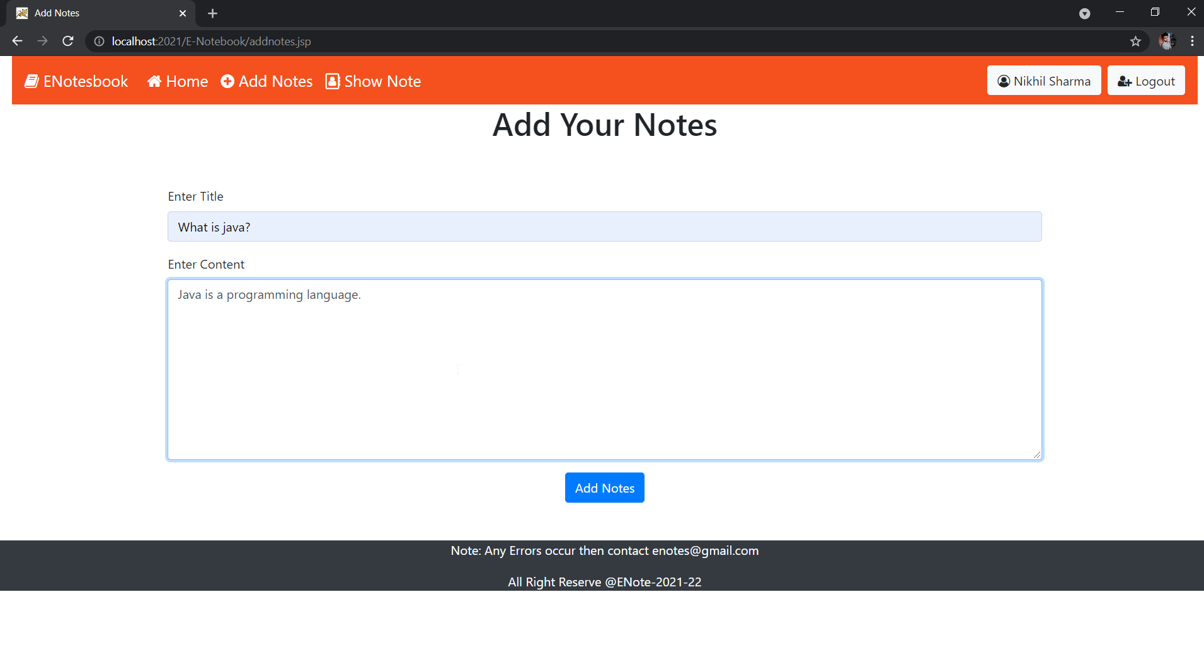
Add notes page

Slide 15
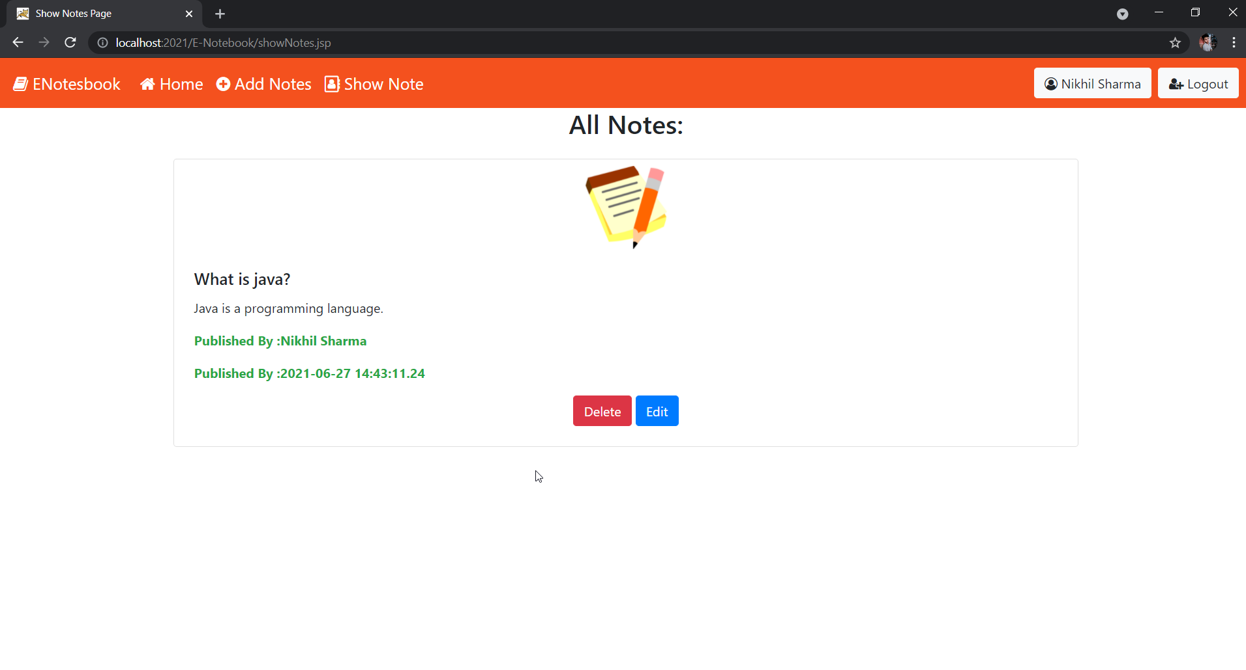
Show notes page

Slide 16
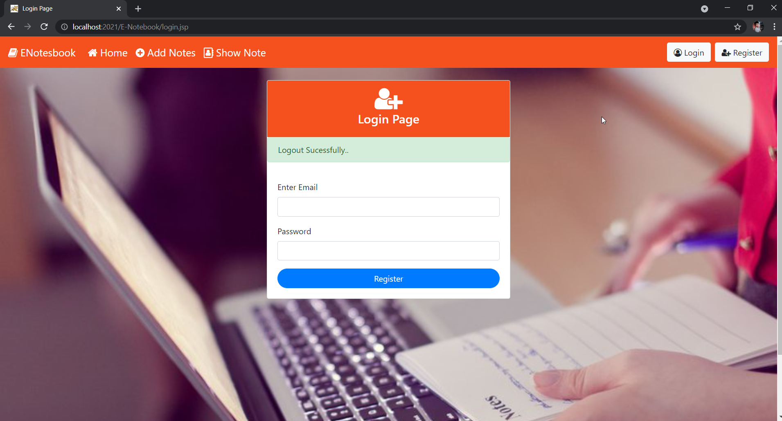
Logout page

Slide 17
FUTURE ENHANCEMENT
We enhance the security of the app.
We enhance the UI of the app.
We can add more and more feature.

Slide 18
END OF PRESENTATION
THANK YOU

